Slide 1
A Two DoF Self Adaptive Bionic Ankle
Dream Aero
Lucas Chen & Justin Guo

Slide 2
Space Exploration
Everyone is going for space exploration:
Elon Musk founded SpaceX, aiming for a migration to Mars
NASA is planning on Artemis III, sending human to the moon
China finished Chang’e 6, the first probe reaching to the backside of the moon
Why? Earth resources are depleting: Overpopulation is a problem
We need to explore Space, in search of resources and living space

Slide 3
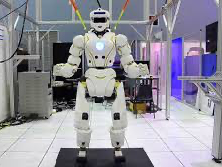
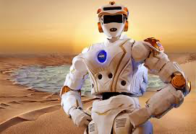
Background Signficance and Proposal
In Space, we are not going to build flat roads during our exploration. We need robots that focuses on movement ability, including the ability to move through rough terrain and great cliffs. These robots are taking the role to going on a mission to Mars.
The machinery need to stabilize and adapt to the unknown surroundings.
Proposal: A good leg, or more specific, a good ankle will help the machinery to traverse better in space environments.

Slide 4
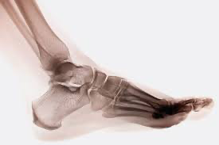
Why Human Ankle?
We need an ankle that have the ability to travel in all kinds of terrain.
Human ankle:
exceled at balencing,
travel in different environments,
is stable in these different environments,
and is energy efficent

Slide 5
Innovation
Which will include:
an additional motor to control not only the leg's dorsiflexion and plantar flexion, but also inversion and eversion movement of an ankle in human leg
a self adaptive program for it to aid movement
the usage of motor system to simulate the muscles in human leg
the usage of springs to simulate the shock absorption mechanics in human leg

Slide 6
Challenges with a 2 dof bionic ankle
1. Mechanical Structure: How are the two motors in the ankle goint to be placed?
2. Reaction to the Ground: How does the bionic ankle sense the ground?
3. Connection: How should the motors and the sensors collborate?

Slide 7
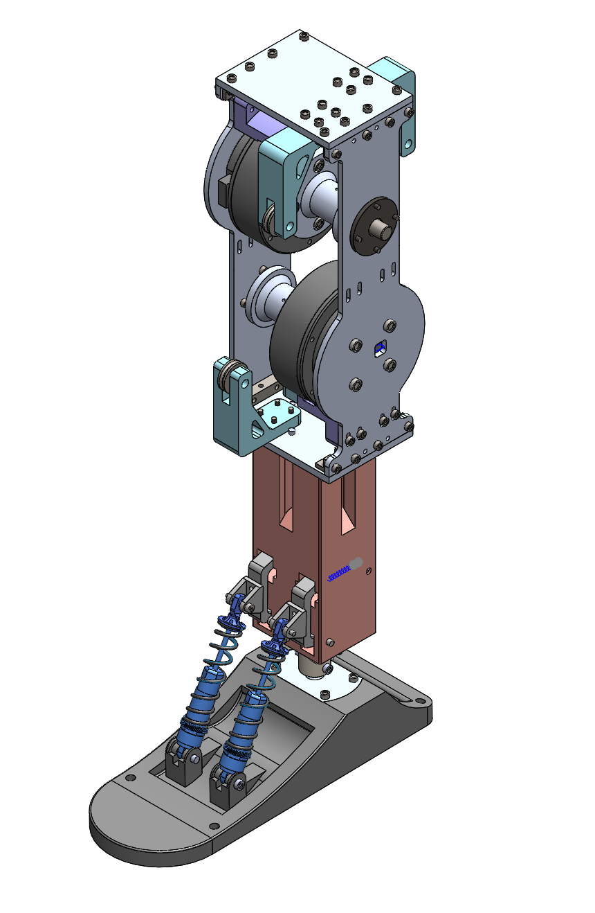
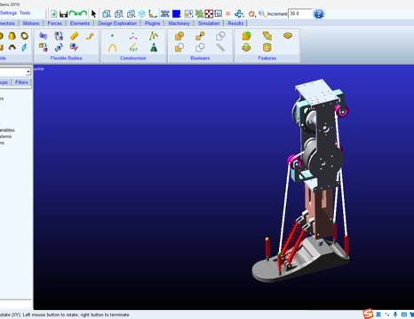
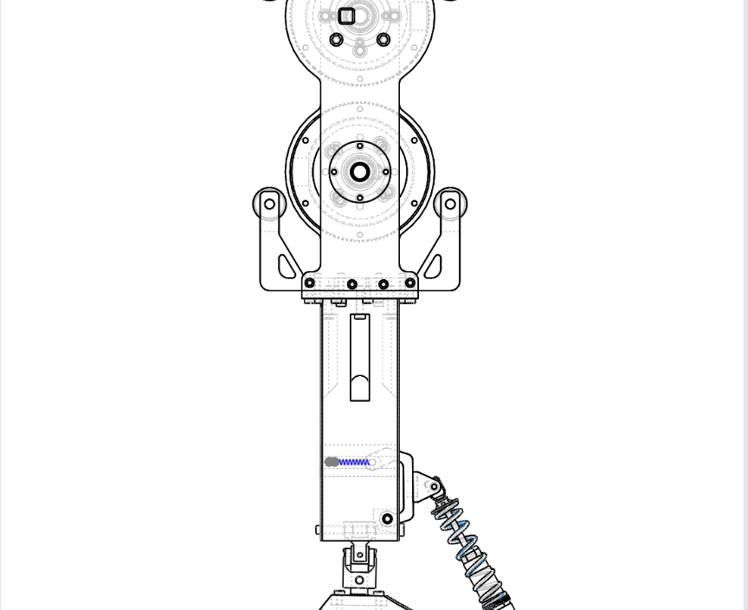
Structural Design
Use Solidworks to plan out the whole structure and record the parts needed to build the whole structure.
Motor-string system to balance the weight of the object
Usage of springs to absorb shock
3.17 – 3.31

Slide 8
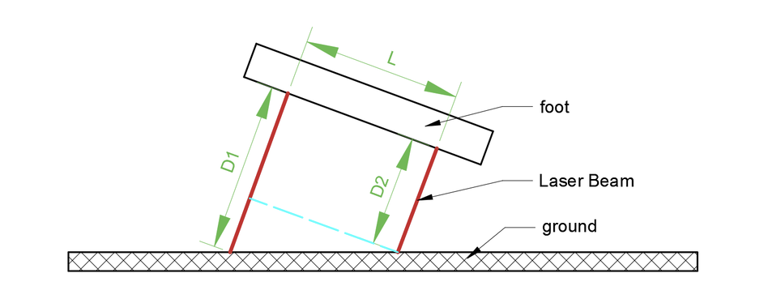
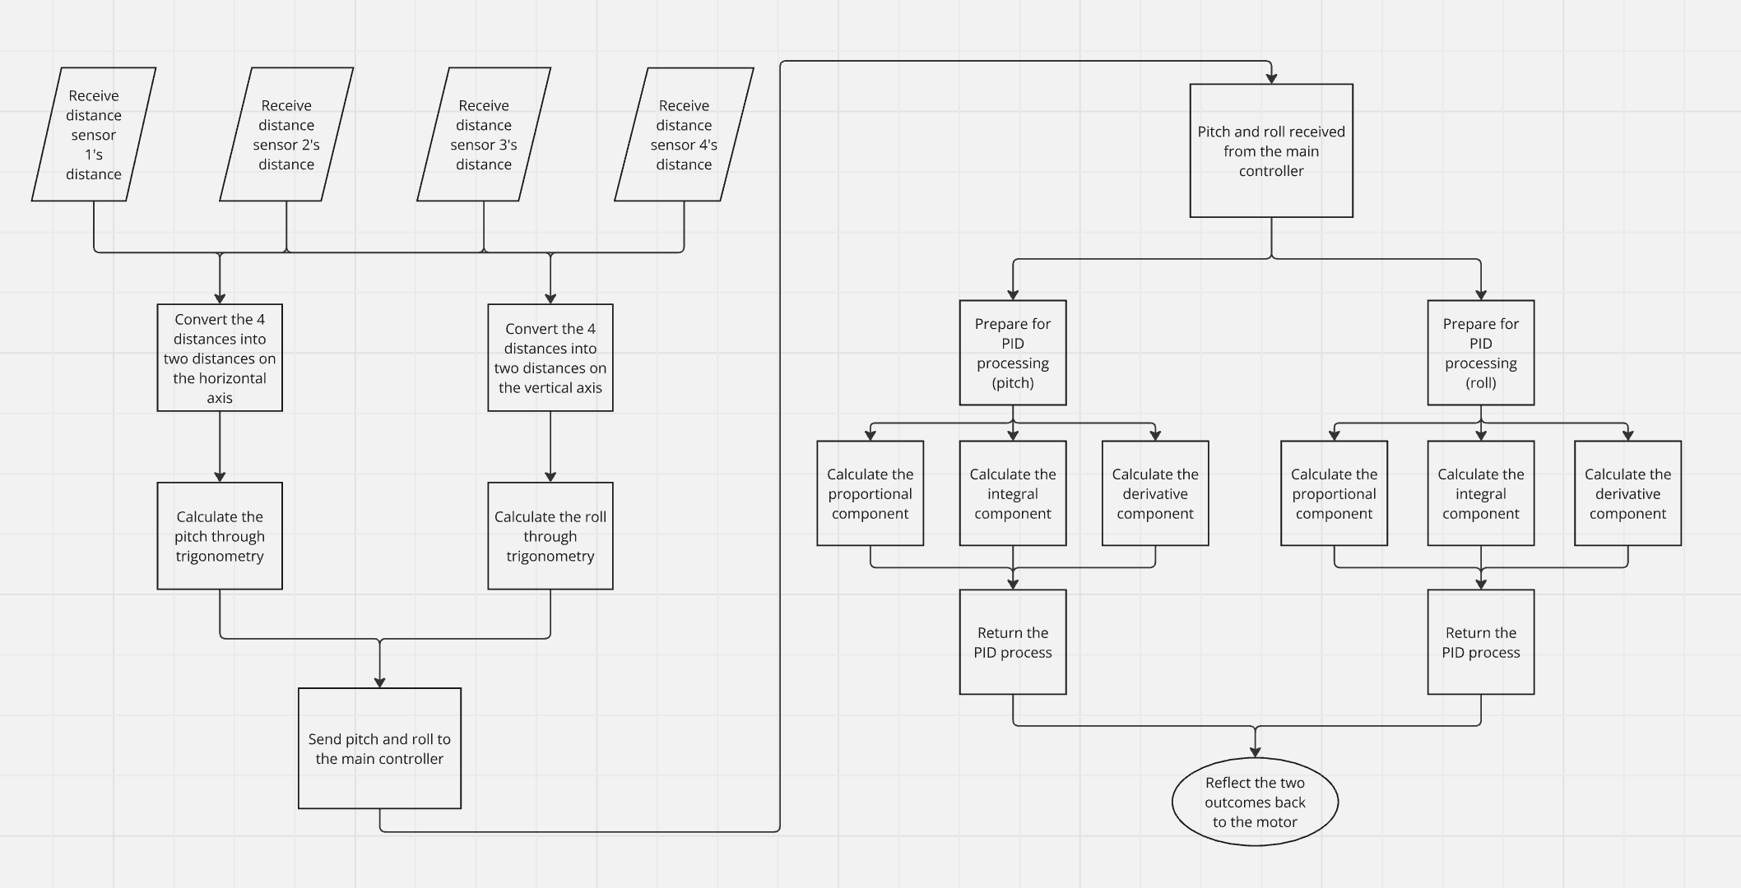
Software Programming
The laser distance sensors is implemented with the right diagram.
The PID controller will self-adjust the two angles, roll and pitch to quickly and efficiently adjust the angle of the foot, making it parallel to the ground.

Slide 9
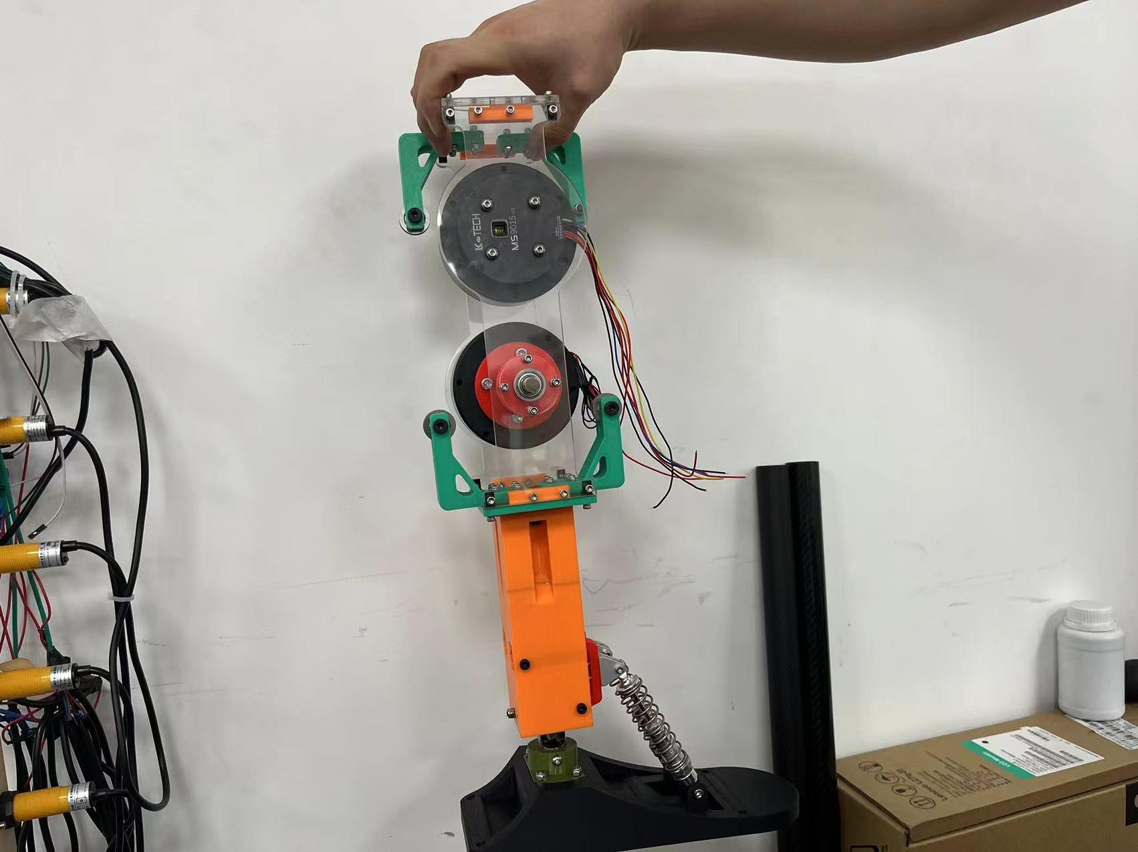
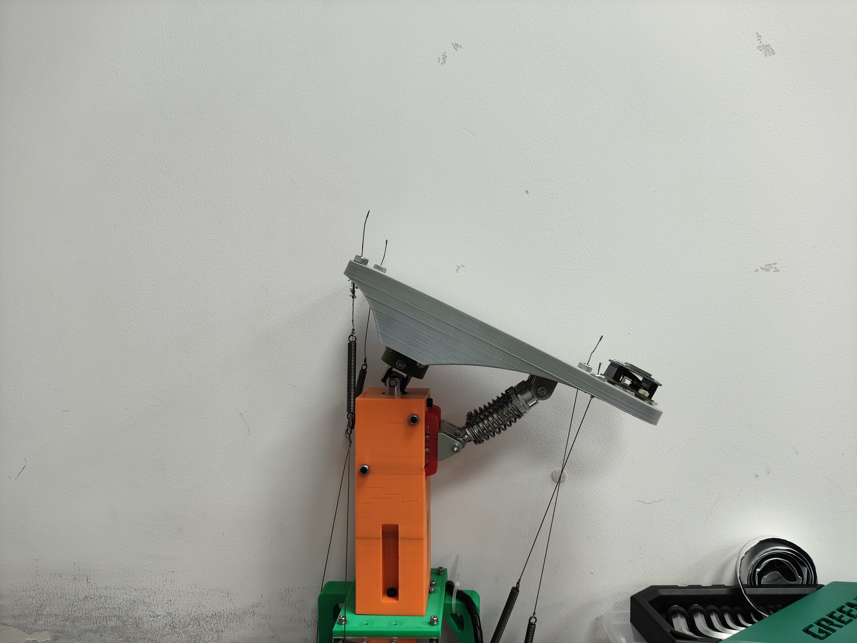
First Model
After testing out the whole ankle in a virtual environment, we started on the first prototype of the bionic ankle to work on the code.
For the framework of the model, we used 3D printed materials, which makes it easy to replace.
The adaptation process was simulated with two gyroscopes.
4.5 – 6.24

Slide 10
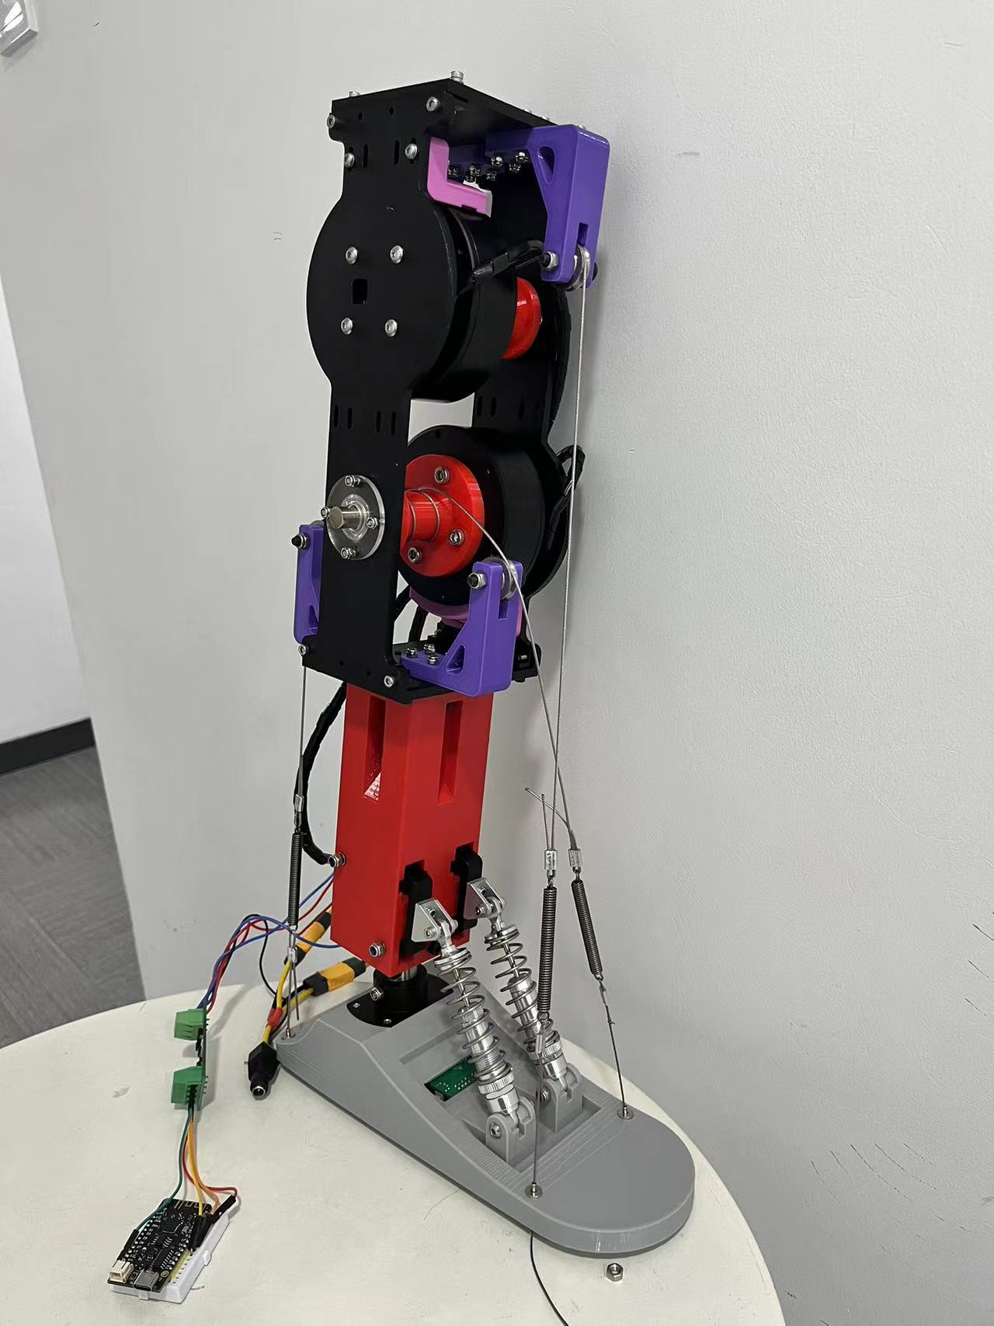
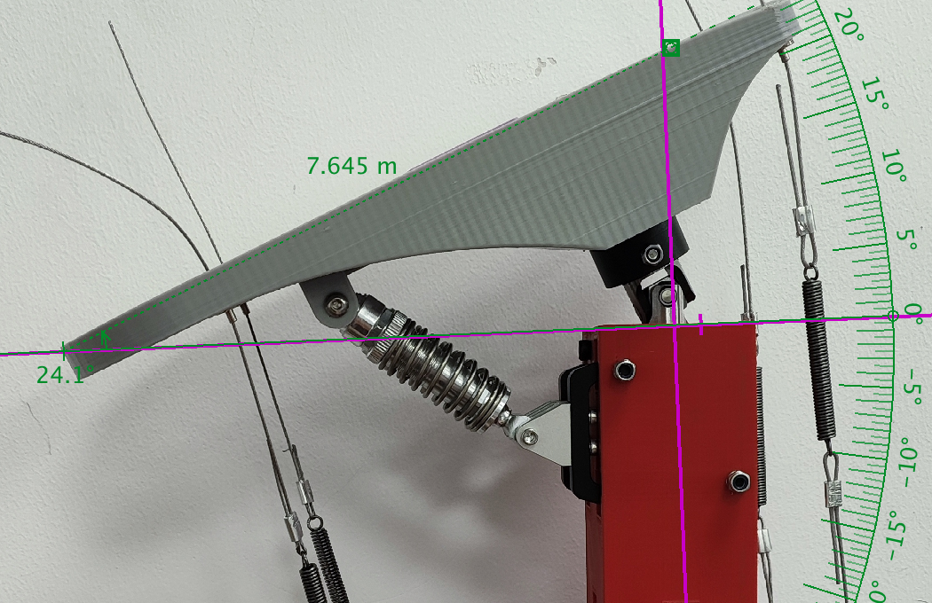
Second Model
3D printed materials cannot withstand the force exerted by the motors, so aluminium boards are needed.
A damping is needed to use up the additional motors force.
6.24 - now

Slide 11
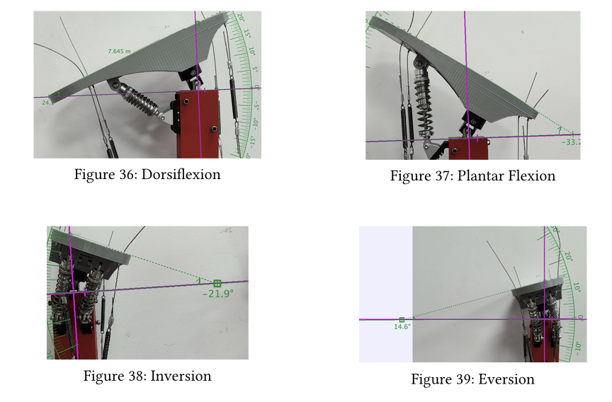
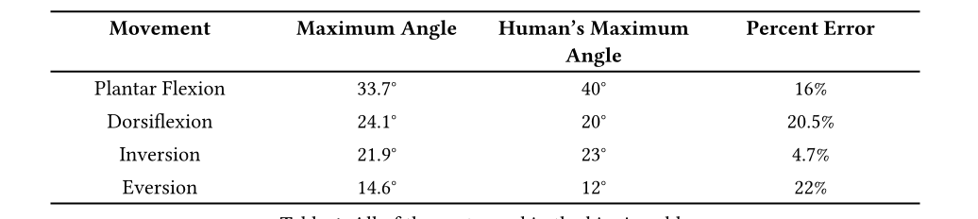
Maximum Angle Experiment
I use my hands to turn the motor such that the foot is in the extreme position. Even if the foot can still move further, it is unnecessary because the strings are too strained to be stable and safe.
I take a picture of the lower part of the foot with the bottom face of the supporting leg perpendicular to the photo frame, and the bottom face of the foot perpendicular to the photo frame.
I use Tracker to analyze the photo:
Take the bottom of the supporting leg as the x-axis, since it is perpendicular to the photo frame, the bottom of the supporting leg is represented by a line.
Use the bottom of the foot as the other ray that locks the angle with the x-axis. The intersection between the line formed by the bottom of the foot and x-axis is the center of the protractor.

Slide 12
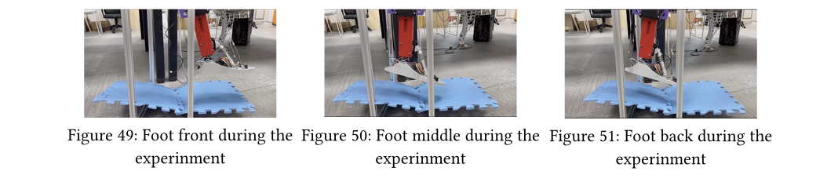
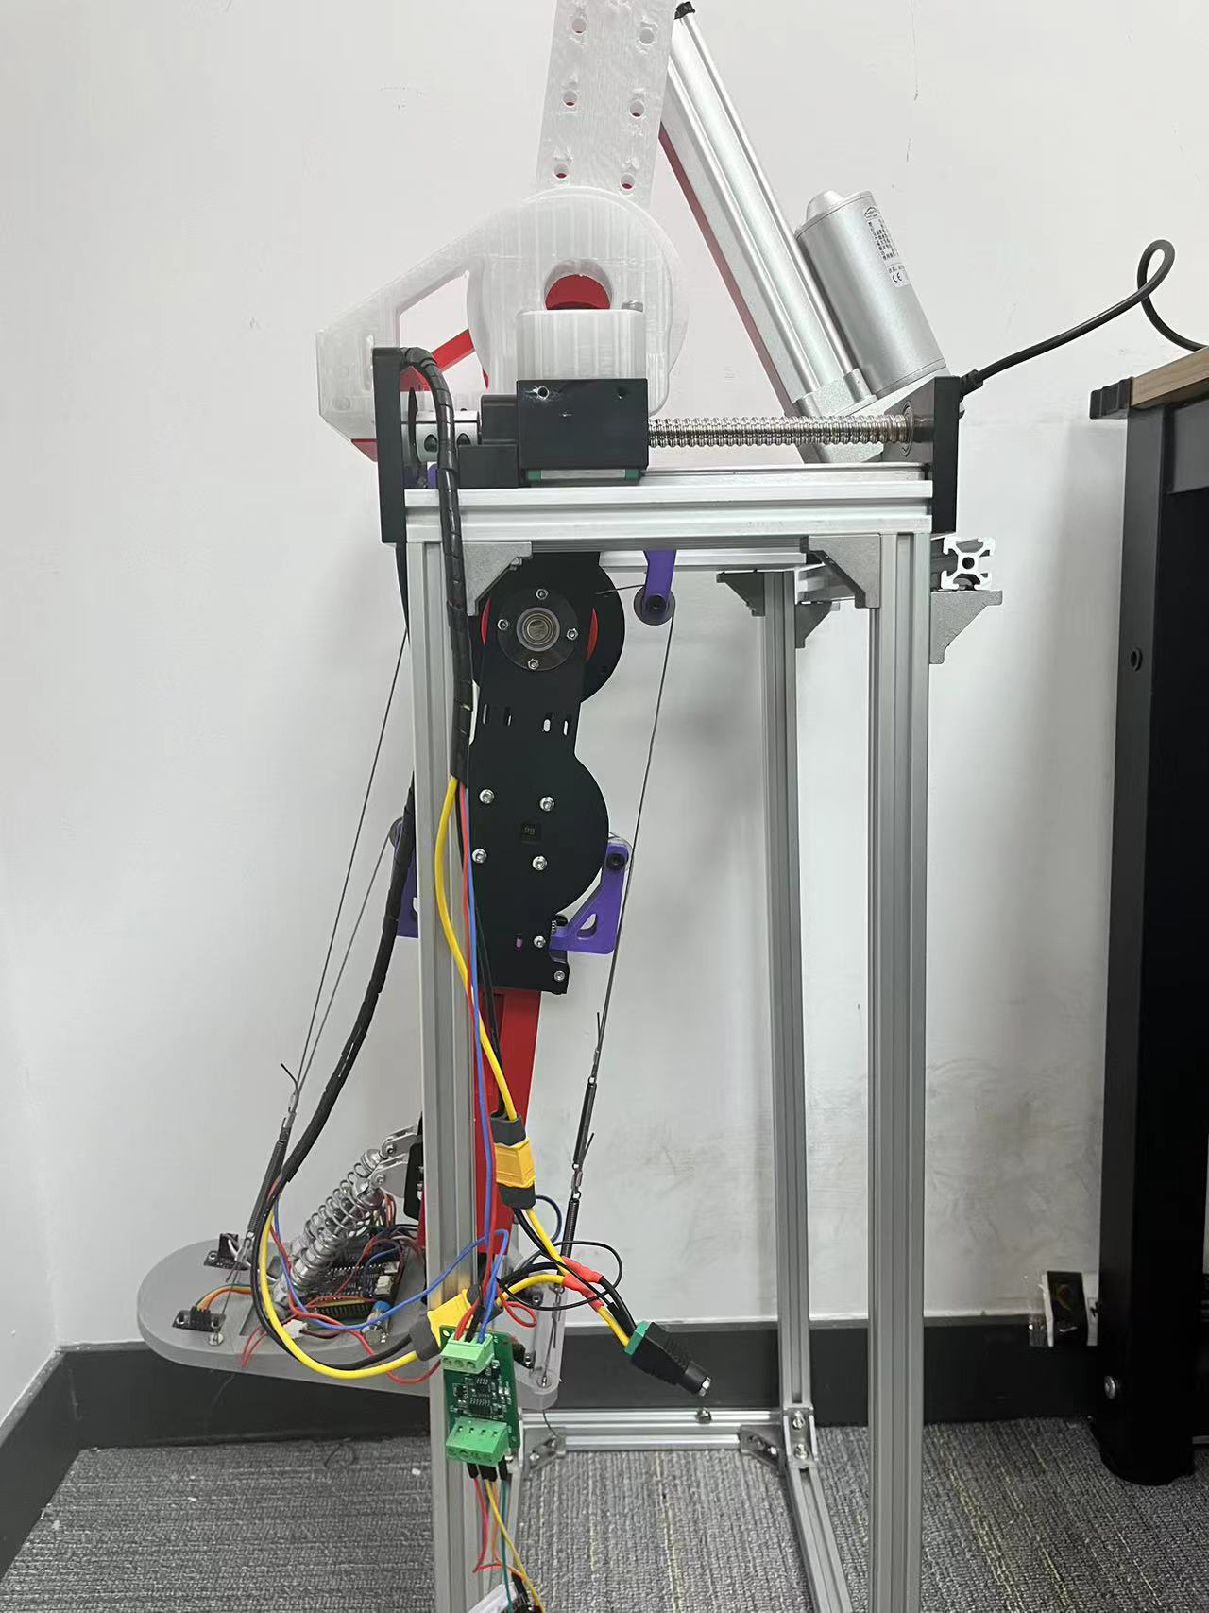
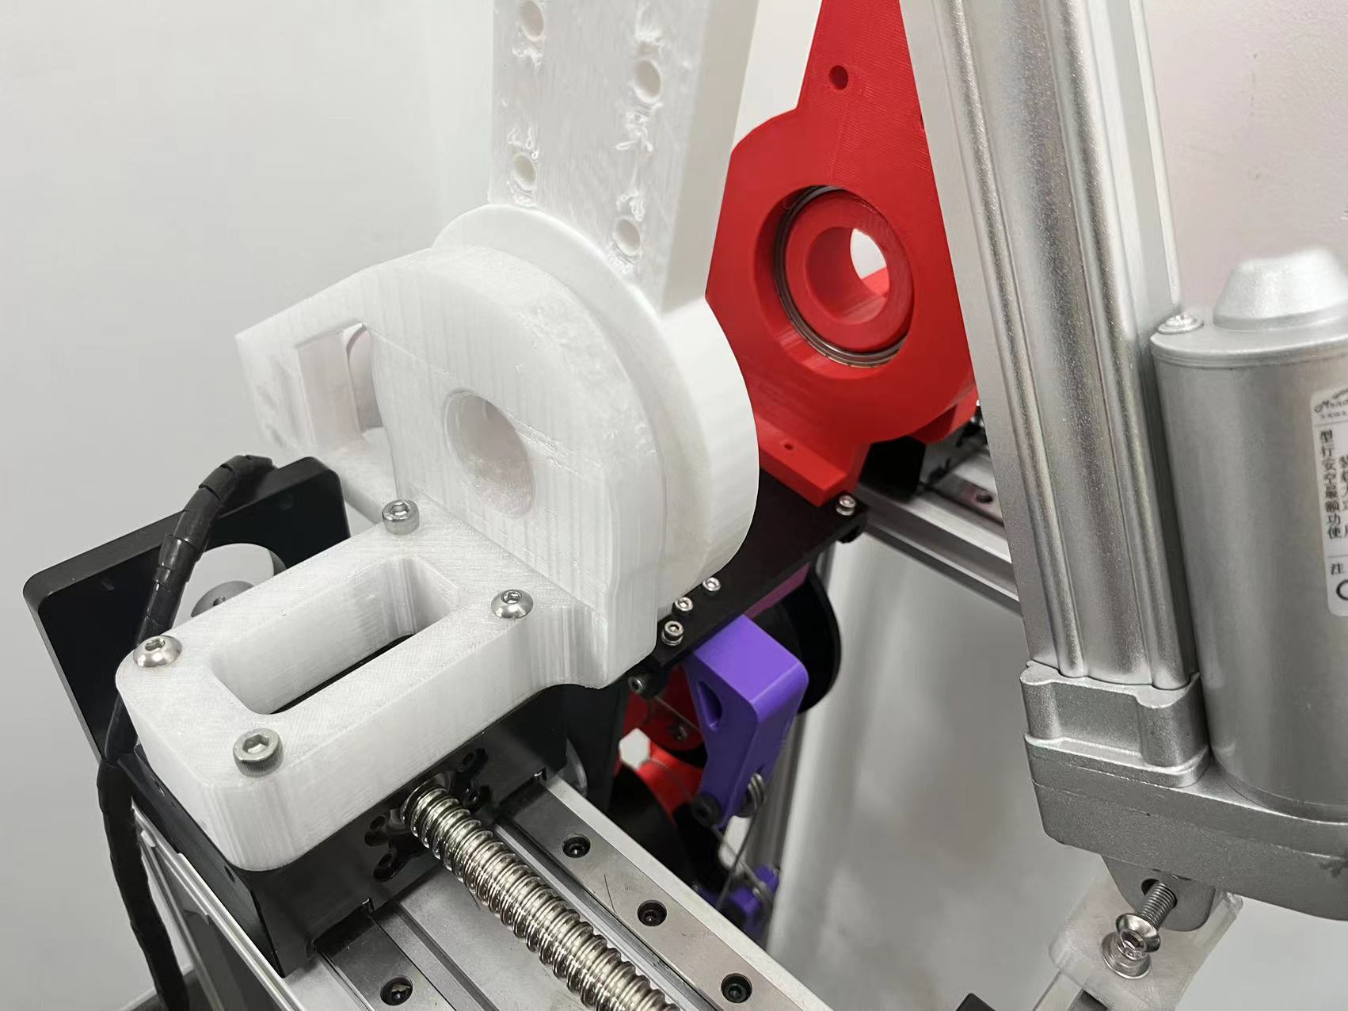
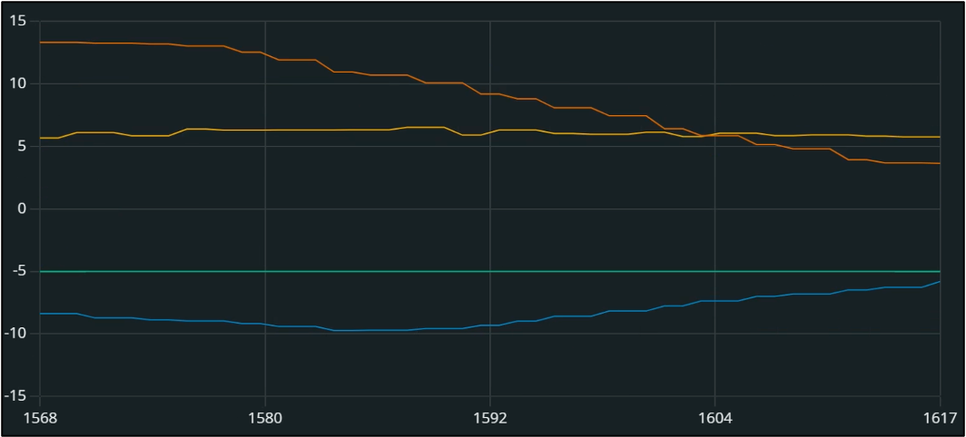
Self Adaptive Experinment
To test the capability of the foot, I build a frame to hang the bionic ankle and oscillating it back and forth using a putter.
As shown below, the foot can adapt to uneven ground.
The Graph displays the enclosing of the foot’s pitch and roll to the ground’s pitch and roll. The time is in milliseconds, which is very fast.

Slide 13
Future Improvements
In this prototype, we have sucessfully demonstarted the basic functions such 2 dof bionic ankle
Future experinments on low gravity environments for examination of impactagainist ground (springs)
Experinment on different foot types for different situations (such as for stability on rough ground)
Coordination of ankle with legs and upper body

